Slide 1

Road to 5G,
Built on Fibre

Slide 2

Agenda
Data Explosion and 5G
5G Rollout – Network Requirements and Role of Fibre
Why Fibre is Best Deployed by Experts
Reliance Jio- Case Study

Slide 3
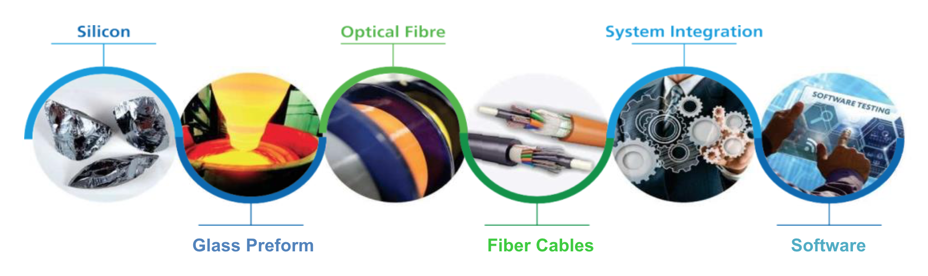
Sterlite Tech is Present Across the Value Chain
Only company in the world to have integrated silicon to software offerings
We deliver excellence across the technology stack to help CSPs in every step of their network creation
Presence in over 100 Countries
Partnering with 8 of top 10 Global Telcos
40% of India’s Data runs on Sterlite Fibre
Group contributes 1% of India’s GDP
With 7 Facilities, across 4 locations and unique end-to-end capability, Sterlite Tech leads in designing, building and managing smarter networks

Slide 4
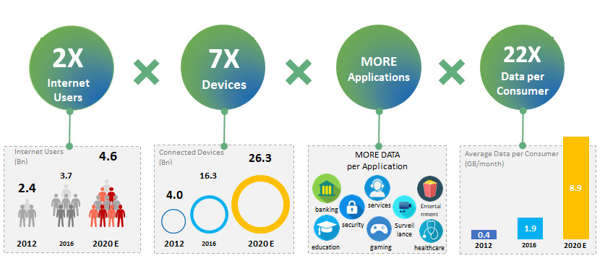
Data Consumption is Exploding – The Age of More
The world is transforming at a fast pace and data transmission is at the core of this transformation
We now have MORE USERS, MORE DEVICES per user, MORE GB’s per user and MORE CONTENT per device
By 2020, more than half of the world’s population will be connected & data will move beyond mobiles to a world of connected devices
Source: www.internetworldstats.com, statista
Source: Cisco, Gemalto
Source: BGR, Cisco, “The Zettabyte Era-Trends and Analysis” July 2016

Slide 5
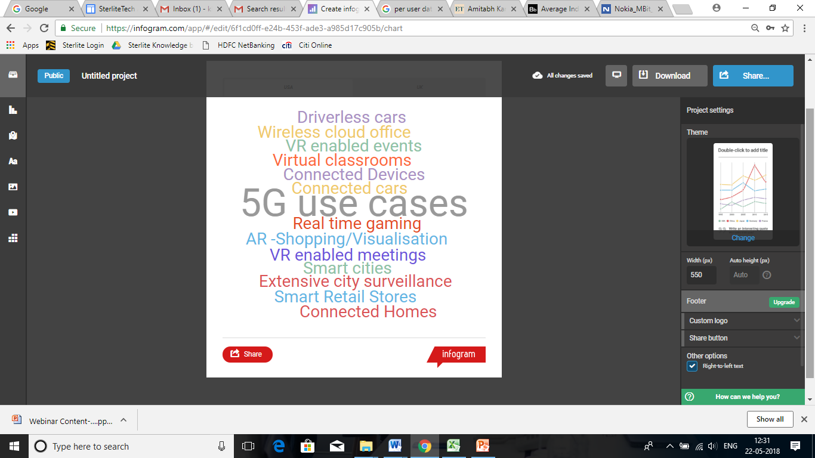
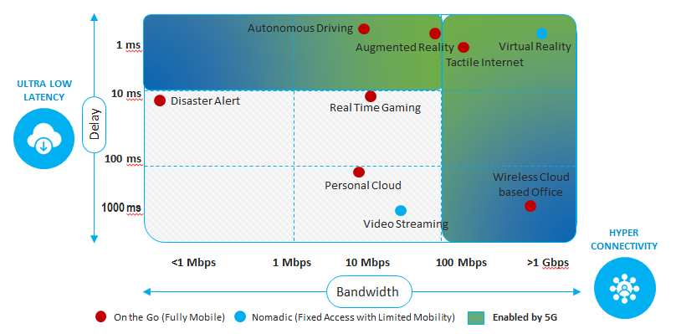
Applications of Tomorrow – Data Guzzlers
The future possibilities are endless. We are likely to see MORE USE CASES for data
Currently people own only one smart device on an average – a smartphone. 5G will enable a connected devices ecosystem – connected home appliances, vehicles, medical devices, machines and equipment
Speed and Latency Requirements

Slide 6



Leading Telcos say – Fibre Imperative for a Successful 5G Rollout
“We view fibre as the cornerstone building block for the network; the next generation network, and that network is going to look very different than what we have built in the past.
If you look at 2G and third generation and fourth generation wireless, it was about capacity and throughput. Fifth generation is about those things where we are going to see a 100 times faster throughput, but we are going to see things like latency of a network , that a network will go out and come back and respond in less than the time it takes to blink your eye.
We are going to see 10 times the battery life that we’ve seen in the past. That opens up a whole new set of applications for consumers and enterprises, but you can’t do it if you don’t have fibre deep into the network compared to what we’ve done in the past.”
Lowell McAdam, Verizon Chairman & CEO
18th April 2017
“It all starts with fibre.
Fibre accelerates everything that businesses need to digitally transform. Without fibre, innovative solutions like highly secure networking, cloud computing, and 5G wouldn't be possible.
As we continue to expand our national fibre network, we want businesses to take full advantage of our fibre highway that is essentially right to their doorstep.“
Mo Katibeh, CMO
5th February 2018
“Telefonica Germany is not yet prepared for 5G given that it still needs to upgrade its mobile antenna sites across the country with fibre
Instead, Telefonica Germany’s plan is to upgrade all of its mobile sites with fibre over the next five years so that they are equipped for the high data transmission rates and low latency 5G requires
While the new 5G technology will be “disruptive”, it will not be a “revolution”. Telefonica will begin a broader rollout of 5G in 2020 and 2021 following tests in 2019, with applications of the new mobile standard to come later when the network is completed”
Martin Cayetano Carbajo, CTO
4th May 2018
Source: https://www.lightwaveonline.com/articles/2018/02/at-t-plans-fiber-optic-network-expansion-to-deliver-improved-technology-to-businesses.html
Source: https://www.telecompaper.com/news/telefonica-germany-to-upgrade-mobile-sites-with-fibre-over-next-5-years-for-5g--1243019
Source: https://www.cnbc.com/2017/04/18/verizon-agrees-to-1-05-billion-fiber-optic-cable-deal-to-grow-its-fios-platform.html

Slide 7





Industry Investment on Network Up-gradation including Fibre
World’s biggest economies are gearing up for 5G launch
Committing significant resources towards network transformation
Chinese telecom operators expect to spend on 5G networks by 2030
$400 Billion
Globally Fibre Demand is Increasing
Historically 80% of Global Fibre demand is driven by these 5 countries
China
Investment in Fiber infrastructure is required over the next 5 to 7 years
$130 - 150 Billion
USA
Expected investment needed for 5G
$60 - 70 Billion
India
Japanese CP’s to invest for delivering nationwide 5G coverage by 2023
$46 Billion
Japan
South Korea will invest to build 5G network by 2020
$1.5 Billion
South Korea
Source: Industry Reports & company research

Slide 8

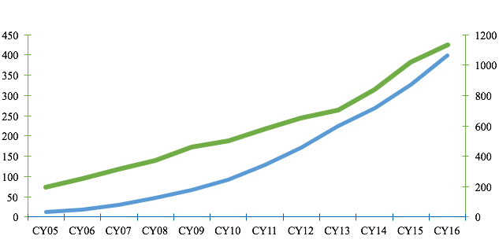
Fibre Consumption is Directly Proportional to Data Growth
Historically, there has been a strong correlation between data consumption & Fibre demand
More Data
More Fibre
CAGR: 17%
CAGR: 36%
Global Annual Fibre Consumption (Mn fkm)
Global Annual IP Traffic (Exabytes)
Source: CRU & Cisco

Slide 9
Fiberized Infrastructure- Key to Sustainable Future
Peak Data Rate -Mbps
Global Deployment in Mfkm
Data consumption is expected to grow along with rapid evolution of technologies, such as 5G
2x times fiber could be deployed due to the 5G bandwidth and latency requirements
Surge in data traffic propels growth of Optical Fibre
Mobile 2G- GSM / GPRS
Mobile 3G - CDMA2000 / EV-DO
Mobile 3G - WCDMA / HSPA
4G- LTE & FTTH
5G Network
4.5x times fiber deployed due
to the shift from 3G to 4G+FTTH
Fibre is the best & most efficient medium to support exponential data demand growth
Source: Qualcomm & CRU

Slide 10
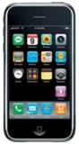

Fibre is Getting Closer to the Point of Consumption
Fibre has played a key role in 2G, 3G and 4G roll outs
5G is all set to bring Fibre closer to the end user
2G Era
3G Era
4G Era
5G + FTTH Era
Major cities
most cities, towns, sub-urban areas
Fibre is connecting:
between towers, as backhaul
small cells, buildings, homes
Being deployed by:
OTTs and Content Players
Conventional Telcos
CSPs / DSPs

Slide 11
5G Infrastructure Requirements for Roll Out
1
More end points & Edge networks
Significantly more endpoints in the
access network
Deep fibre in the access network for mobile and fixed networks. Each 5G front haul will require 1 fiber pair
Increase of uploading will require symmetric speeds: 1 to 10 Gbps and latency of 1ms
Increase AFC to reduce need for optical splitters (reduce losses during splitting)
Future proofing and cost reduction
Fibre is only ~10% of overall deployment costs
Deploy higher fibre count cable to reduce installation costs per fibre
Imperative to deploy enough capacity for future expansion
Proximity data centers and
Edge networks
Proximity data centers- content moving closer to user to improve QoE
Move IP layer 3 management to edge of the network

Slide 12

5G Infrastructure Requirements for Roll-out
2
More number of cells
5G will require 20-30x the number of cells of a conventional cellular network
Implications on Fibre Requirements
Typical LTE cell coverage Typical 5G cell coverage
~550+ Meters1 ~100 Meters2
5G deployments will require fiber for backhaul: backhaul will constitute 15-30% of 5G deployment costs
Fiber requirements for 5G likely to be 3-5X for same coverage for 4G in the massive MIMO mode
Governments will need to play a critical role in providing incentives for enabling the same
1 For typical 2.1 GHz LTE base station in urban area
2 For 5G small cell based on >5GHz+ spectrum in urban area
Source: McKinsey

Slide 13
Designing a High Capacity Centralized Fibre Grid
Today’s Network Fabric
Tomorrow's Network Fabric
C
C
AG
Mobile Access
Common Access
C
C
Common Access
C
C
C
AG
C
FTTH/ Enterprise
C
C
C
C
C
Common Access
Metro/LH
C
Metro/LH
Distributed Architecture (Hybrid)
Centralised Architecture

Slide 14
Why Fibre should be Deployed by Experts
Fibre deployment by experts can add more value to CSPs, while enabling them to focus on their core competency
It will enable capex & opex optimization hence deliver more site efficiency
Capex Optimization
Reduced Opex
Revenue Uplift
Improved design
Efficient routing through a holistic city-wide approach
Reduced O&M costs
World class execution leading to less outages
Faster execution
Use of state-of-the-art roll out machinery (e.g., German HDD)
Increased Fibre Life-Time
World class execution minimizes the need for Fibre replacement
More efficient O&M
Clear inventory combined with word class design allows more efficient repairs
Lower downtime
Reduce revenue leakage
Increase customer experience (lower churn)

Slide 15
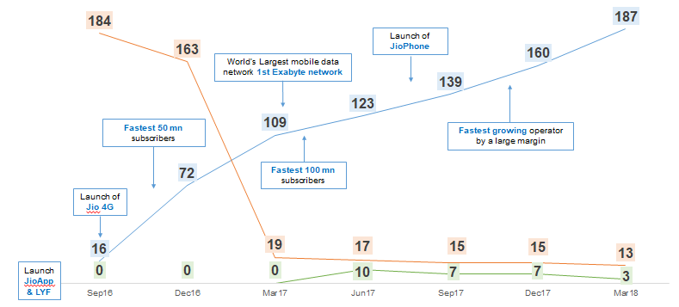
Disrupting the Indian Market – Partnering with Reliance Jio
Fastest Subscriber acquisition in the world
World’s first Exabyte (Bn GB) Network
Role of Fiberization
Others*
RJio*
Subscribers (Mn) Other Telco* Price (INR/GB) Jio* Data Price (INR/GB)
Fibre Network [kCkm]
Tower Fiberization %
*Sterlite Tech Estimates

Slide 16

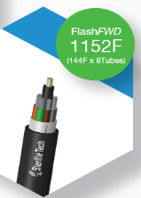

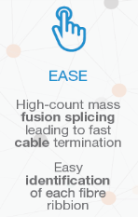
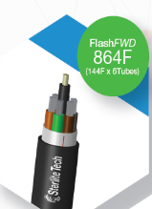
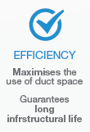

Optical Fibre Cables for 5G Future Ready Networks
Sterlite Tech’s FUTURE READY 5G cables

